Slide 1
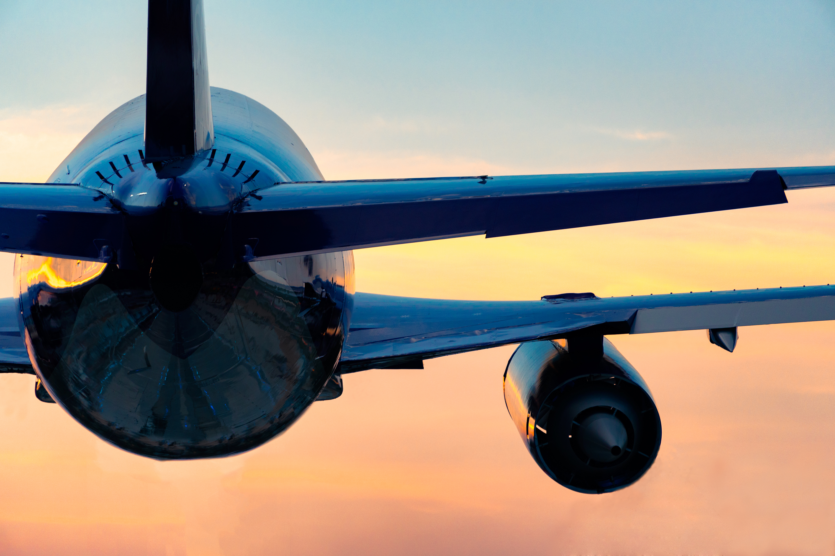

FLY FEARLESS
Rojan Khatri
Bellevue University

Slide 2





4 REASONS WHY?
STRICT REGULATIONS
ADVANCED TECHNOLOGY
HIGHLY TRAINED CREW
STRONG SAFETY CULTURE

Slide 3




BASED ON LIKELIHOOD OF DEATH IN DIFFERENT MODES OF TRANSPORTATION, HOW SAFE IS FLYING?
0.93%
0.14%
0.02%
0.0000091%
(1 IN 107)
(1 IN 700)
(1 IN 5000)
(1 IN 11,000,000)

Slide 4

DECLINING TREND
ACCIDENTS RATE PER 1,000,000 FLIGHT HOURS

Slide 5


DID YOU KNOW?
Airplanes are designed to be able to glide for miles if the engines fail.
Qantas has never had a fatal accident in its 99-year history.

Slide 6

Nearly half of all aviation accidents occur during final approach and landing.
And other 14% during takeoff and initial climb

Slide 7
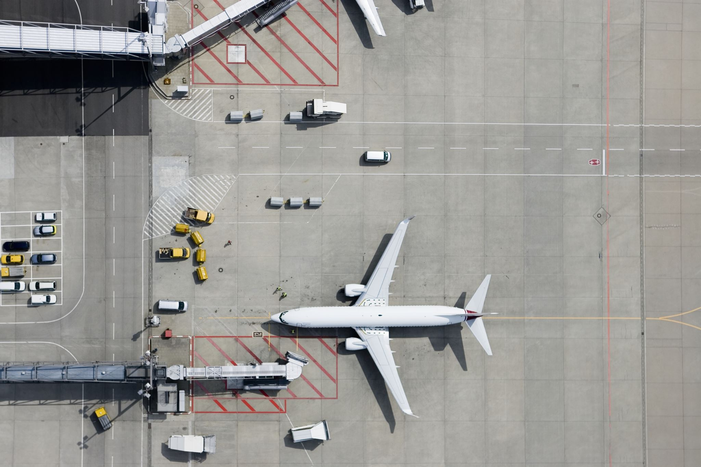
Thank you
Air travel is the safest form of transportation in the world.
Dr. David Ropeik, Risk communication expert

